Slide 1

Basical principles ultrasound of periferal nerves and muscles
Session 5
Belgrade ECHC October 15-17, 2021.
Olivera Jovanikic,
MMA, Neurosurgery Clinic, Belgrade Serbia

Slide 2
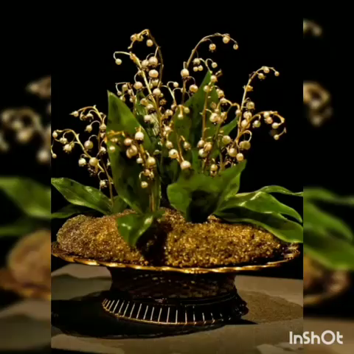
Instead introduction: ART, science, and communication – one part of Collection stone flowers of K.G.Faberge

Slide 3
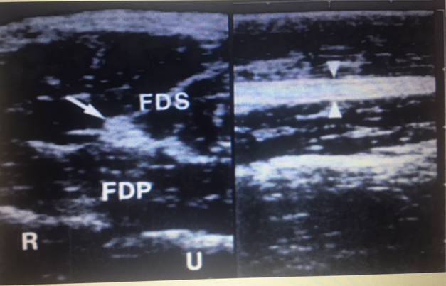
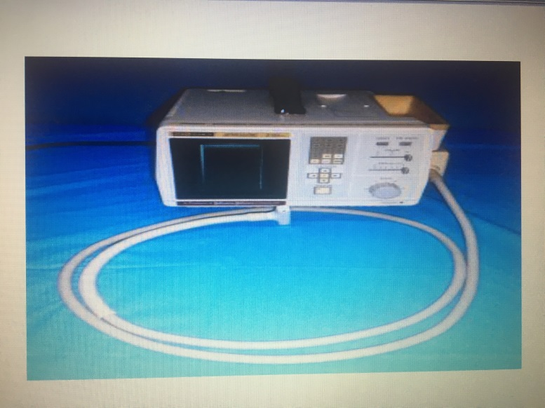
The youngest branch of neurosonography
1988.Bruno Fornage: probe 5,7 МНz first describe of uper extremity nerve: „honey comb“ pattern of nerve, echogenicity and fibrilarity pattern.
The first description of tumor of the nerve (vascularization, hypoechogenicity, nerve thinning)

Slide 4
Equipment and tools FOR periferal nerves and muscles ultrasoNOGRAPHY
High frequency ultrasonography 18-22MHz (penetration untill 1,5cm)
The Probe:
Linear, 10-18MHz, rarely 12-18MHz (brachial plexus, uper extremity, distal part of lower extremity)
Convex probe 7-12 MHz, gluteal region, femoral part of lower extremity,
Special probes, „a pencil“, „hockey stick“, 15-18MHz
Mode:
B-mode,M-modepower-mode;doppler sonography,
Rare : THI(tissue harmonic imaging), VA (Vibroacustography), ARFII (Acoustic Radiation Force Impulse Imaging), SSI (Super Sonic Imaging)
A Resolution : a distance between two poin which can still see as a different
Axial 250-500 mikrons
Longitudinal 0,6mm

Slide 5
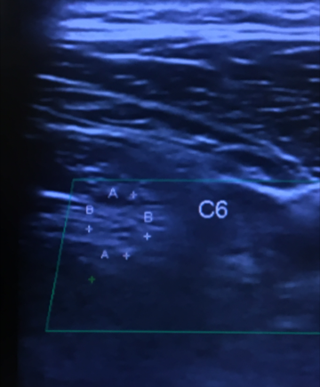
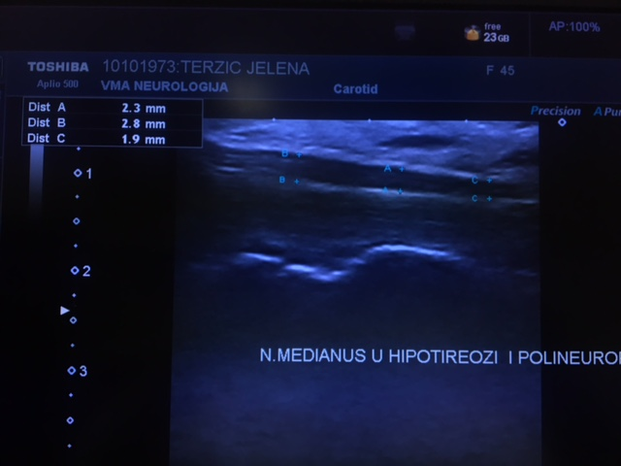
Ultrasound of periferal nerves: the examination technique
The technics of examination:
Always bilateral examination
Two view- longitudinal and transversal
Examination along the nerves
Dinamic nerve examination
Tillting-specific movement of probe

Slide 6
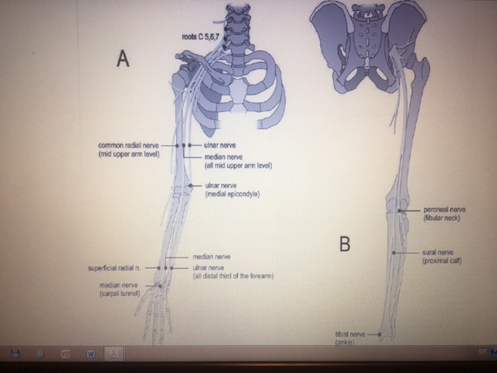
Where we perform the examination of periferal nerves?

Slide 7
The ultrasound of periferal nerves: What we must to describe?
Fascicular and „honey comb pattern“
Pozition and the shape of the nerve,
Relation of the nerve with surrounding anatomical structures
Echogenicity of the fascicles and epineurium
Continuity of the nerve
CSA- cross sectional area /diametar of the nerve
The existence of : edema, compresion, a tumor or a cyst

Slide 8
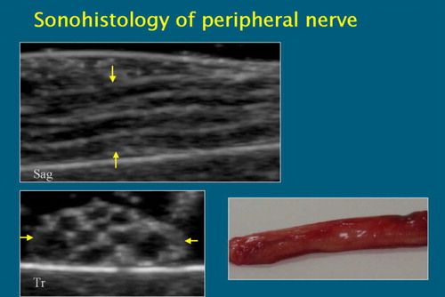
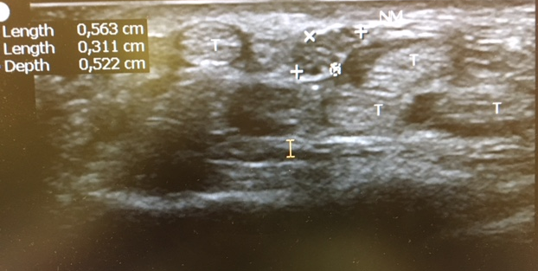
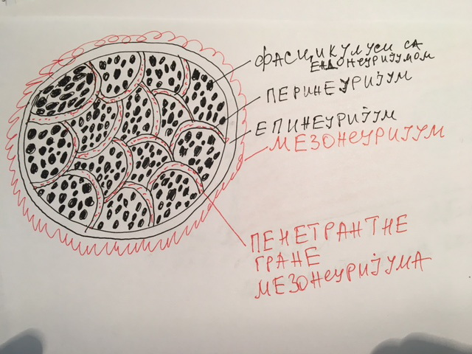
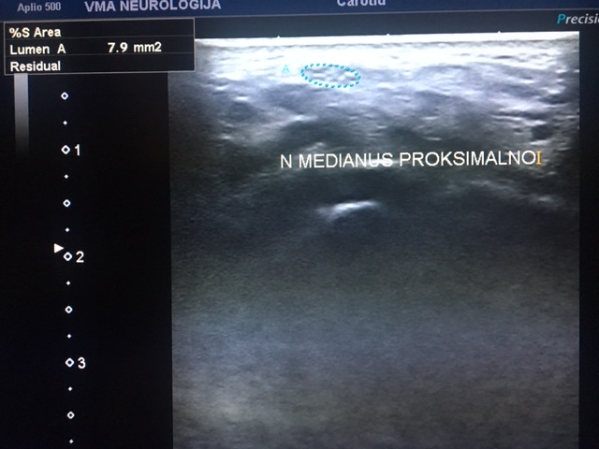
FASCICULAR PATTERN AND HONEY COMB PATTERN OF THE NERVE

Slide 9
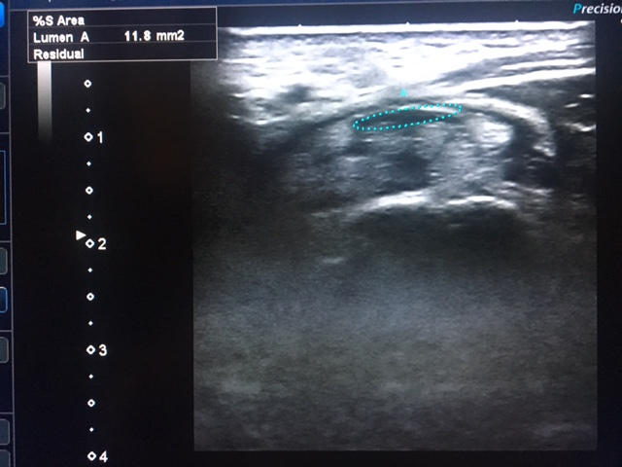
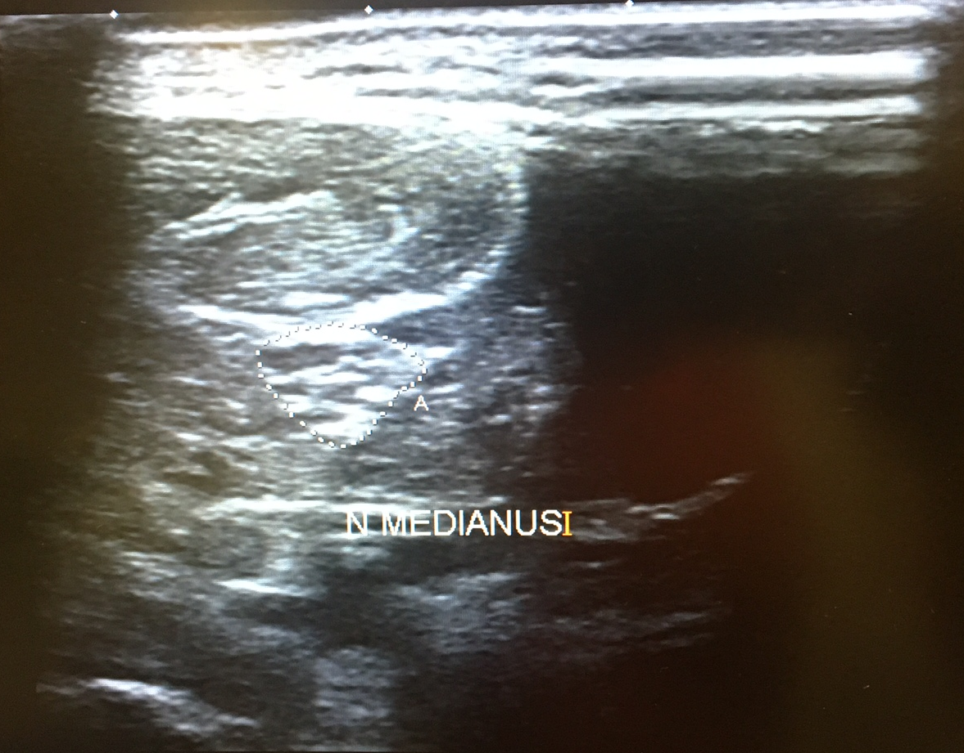
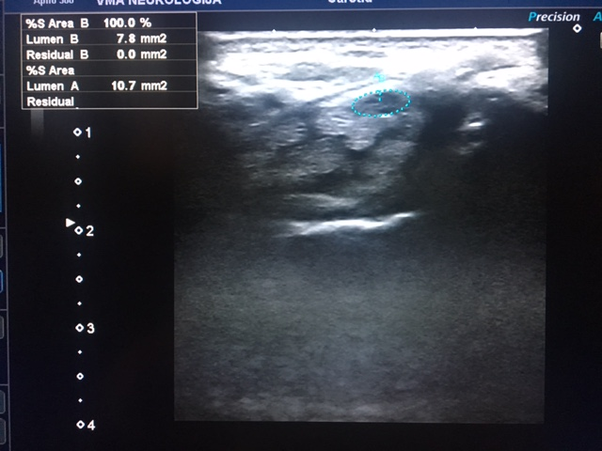
Position and shape of the nerve,

Slide 10
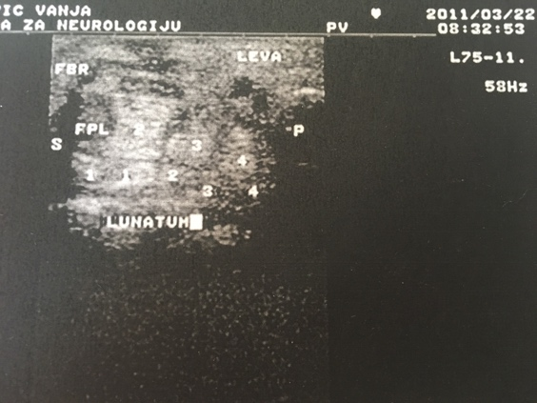
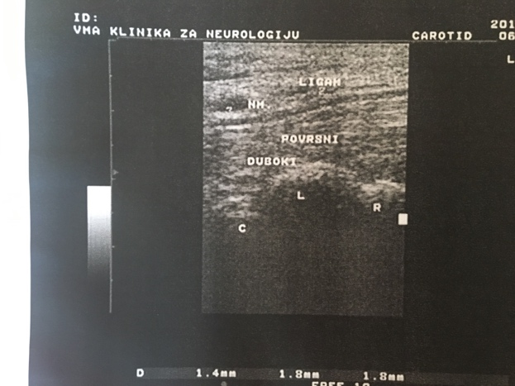
Relation with surrounding anatomical structures

Slide 11
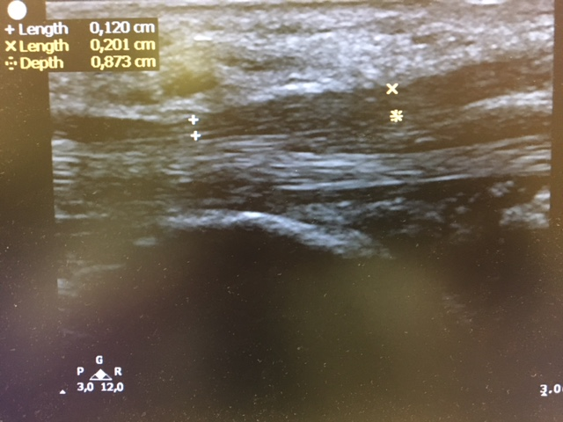
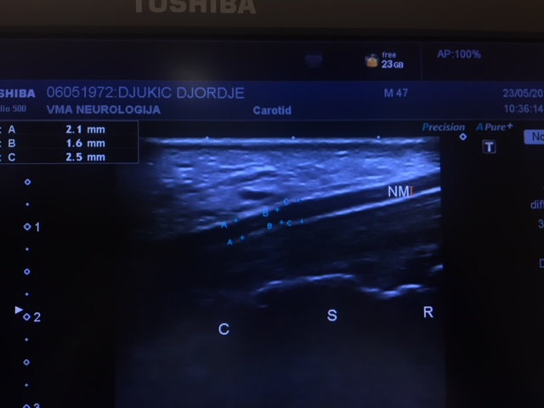
ECHOGENICITY OF FASCICLES AND
EPINEURIUM

Slide 12
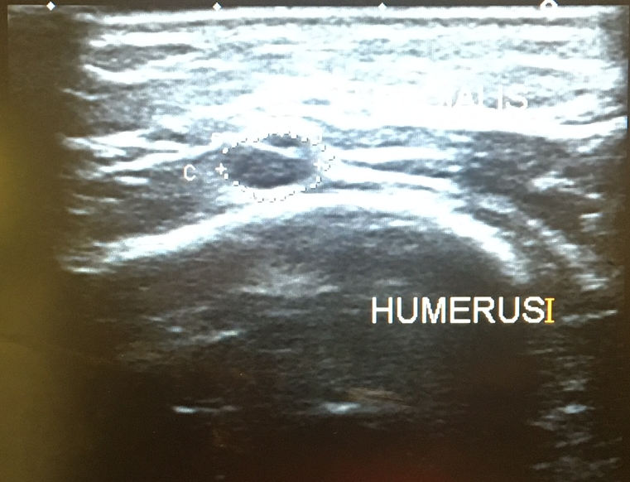
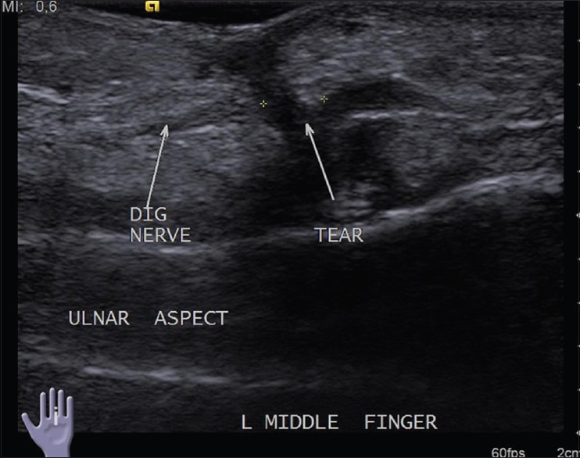
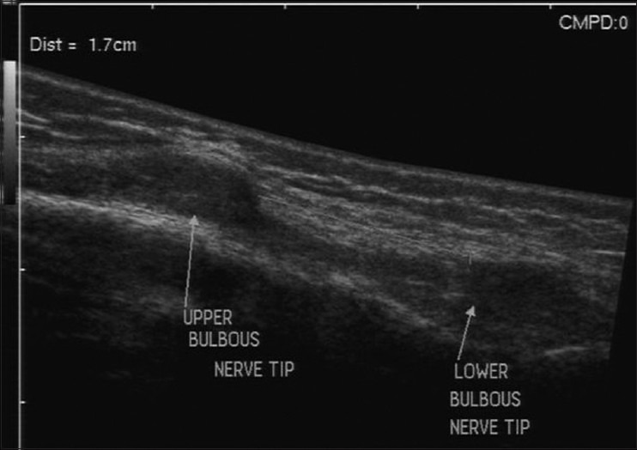
CONTINUITY OF THE NERVE

Slide 13
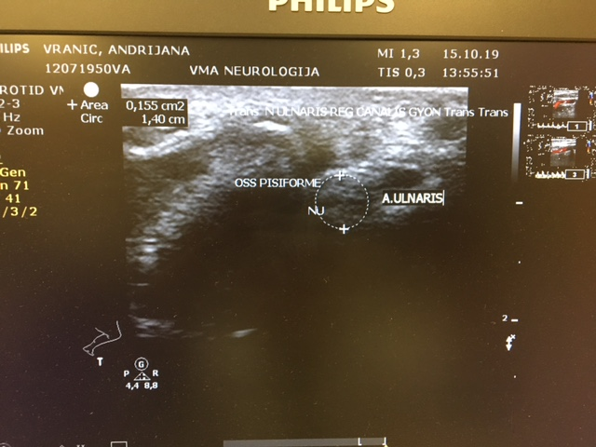
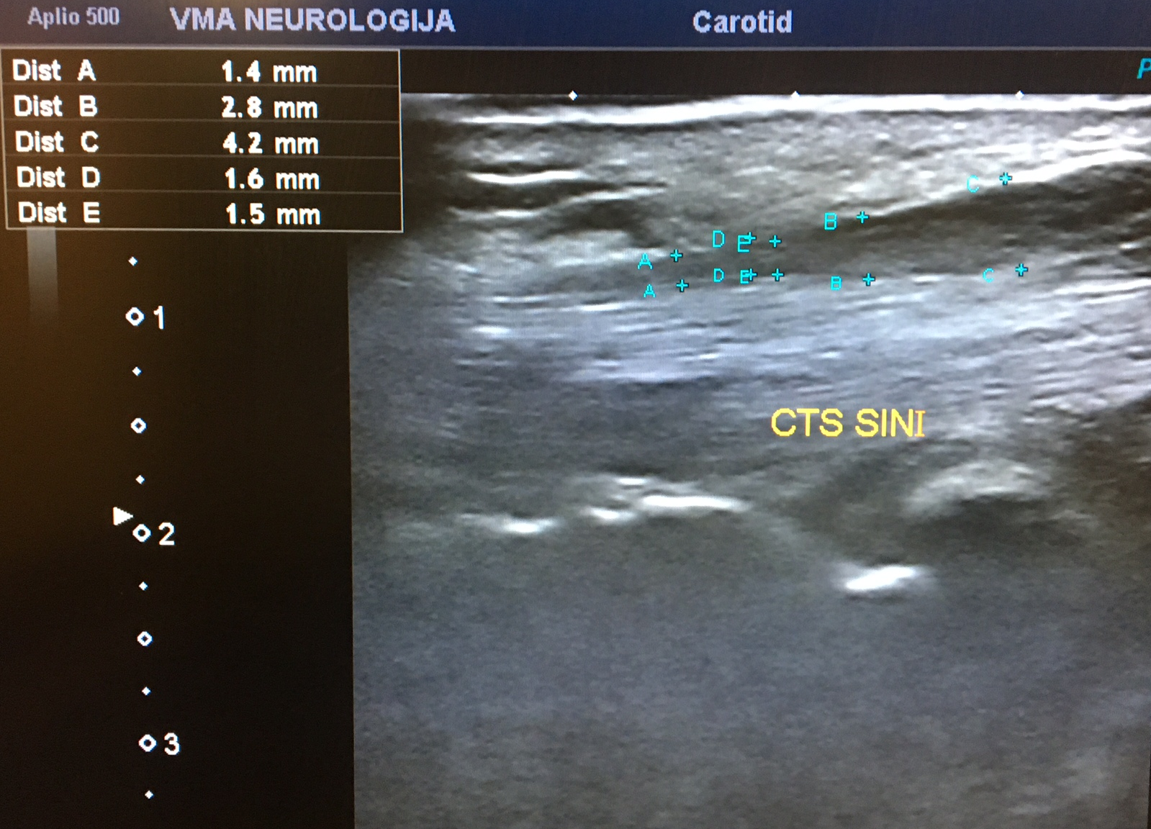
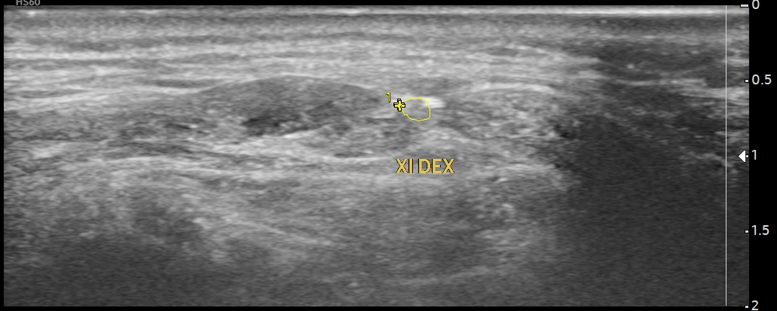
Nerve size: CSA and diameters
Square centimeters
NSI-Nerve Size Index- ratio: tallness to CSA

Slide 14
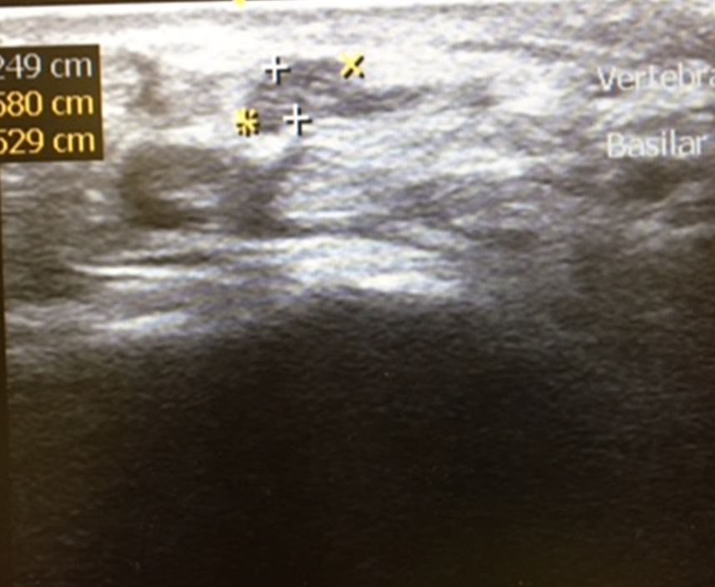
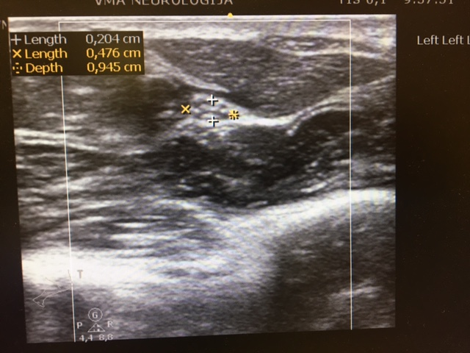
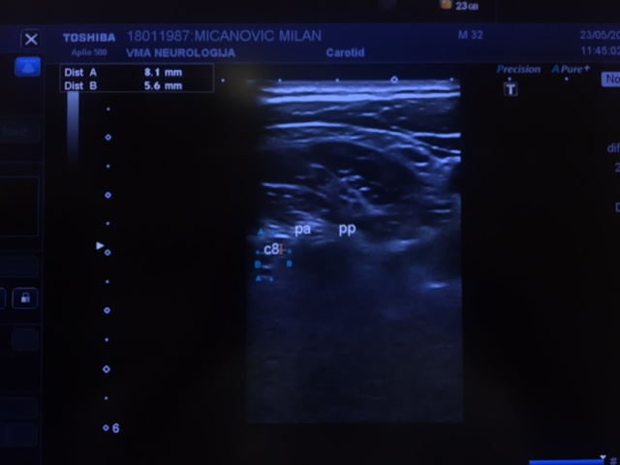

Slide 15
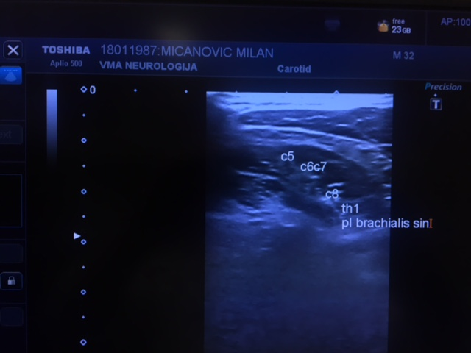
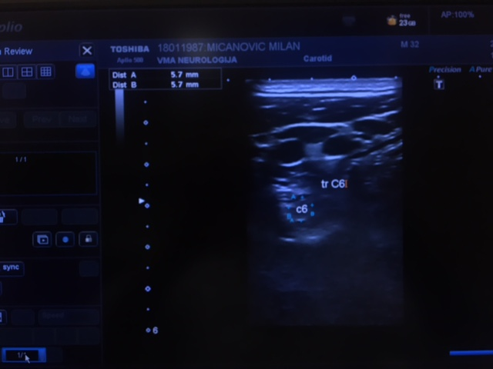

Slide 16
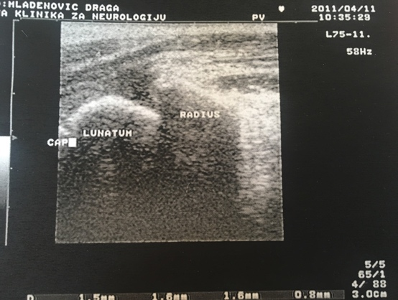
The existence and percentage of edema, compression of the nerve(by the muscle, ligament, scar, piece of the bone , excess bone, abberant artery or vien, arterial or vien thrombosis, cyst, tumor)

Slide 17
Indications for examination performing
Compressive neuropathies- diagnosis and treatment procedure
Peripheral nerve injury: localization, intraoperative navigation, grade of nerve damage
Peripheral nerve tumor: diagnosis; vascularisation, relation with surrounding structures.
Polyneuropathies: multifocal motor neuropathies,Charcot-Marie-Tooth,inflammatory etc.
Diabetic neuropathies: noninvasive diagnosis, treatment of pain, numbness.
Nerve changes in vasculitis
Nerve changes in acromegaly
Postherpetic neuritis- Dg and Th
Amiotrophic Lateral Sclerosis: early diagnosis , assessment of diaphragm function
Nerve changes in amiloidosis

Slide 18
What we CAN describe on muscles images
Thickness of the muscle or atrophy
Fascicular pattern
Echogenicity
Normal contraction pattern
Voluntary movements
Involuntary movements (muscle fasciculations)

Slide 19
Ultrasonographic examination of diaphragm
Noninvasive structural and functional assessment (MRI, EMNG,fluoroscopy, sniff test)
Misdiagnosed condition and underdiagnosed
presentation varied and very frequently is non-specific:
unexplained dyspnea (supine position), difficulty weaning from oxygen or mechanical ventilation,
diaphragm elevation on chest radiographs, unexplained respiratory distress, asymmetric breathing pattern,
paradoxical movement of the epigastrium, recurrent pneumonia, recurrent unilateral lung collapse.
Early diagnosis

Slide 20
EXAMPLE: THE examination of diaphragm
IMPAIRED DIAPHRAGM FUNCTION- INDICATION FOR EXAMINATION:
ALS
Spinal cord injury
Motor neuron disease
Muscular dystrophies
Disease neuromuscular junction
Central nervous system diseases
Hypothermia
Cauterizing, severing or traction of phrenical nerve (Wiplash injury)
Misdiagnosed condition and underdiagnosed, noninvasive structural and functional assesment

Slide 21
Ultrasonographic examination of diaphragm
Two techniques:
1. measuring of thickening
2. the amplitude of movement measuring
The thicknening measuring- basis on the fact :contraction lead to thickening.
Linear probe(7-14MHz), curvilinear(2-6MHz).
B-mod, without any harmonics or M-mod
VIDEO RECORDING! Three cycles of breathing
Always both site examination
First- the connection diaphragm with the chest wall, and than move caudal and show diaphragm during all cycle of breathing

Slide 22
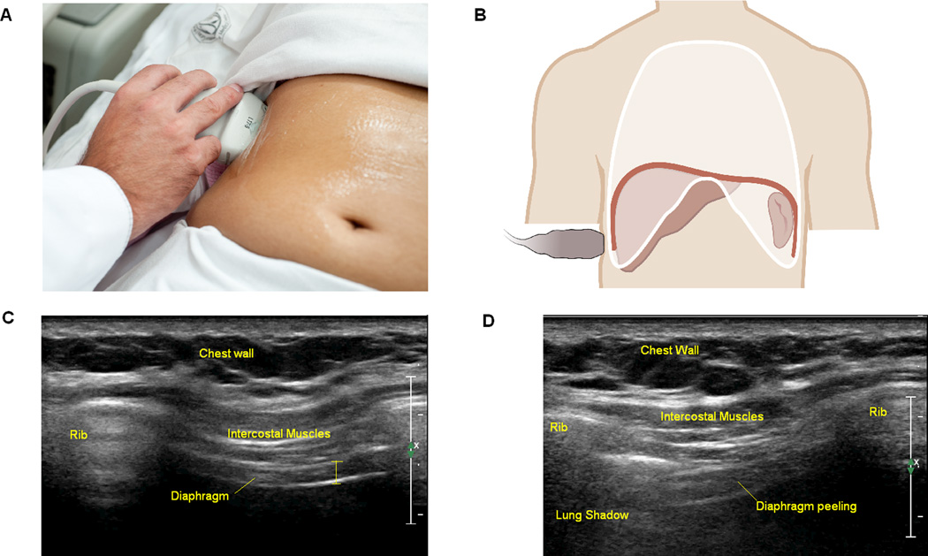

Slide 23
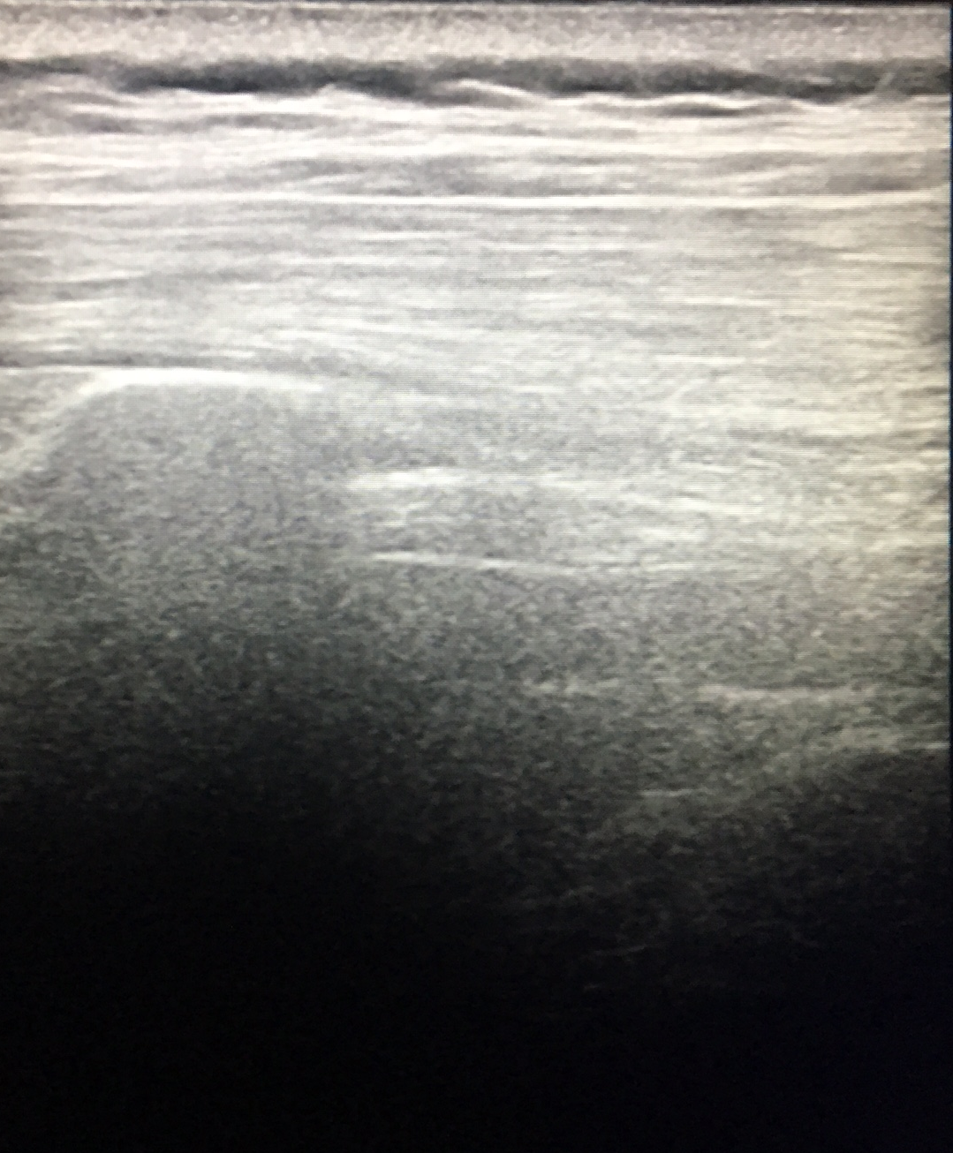
Ultrasonographic examination of diaphragm
Three layers:
The two hyperechoic lines-
parietal pleura ( the upper line)
peritoneum (bottom line)
hypoechoic layer- diaphragma
Probe position:
Intercostal view
Anterior subcostal
Posterior subcostal
Subxiphoid view

Slide 24
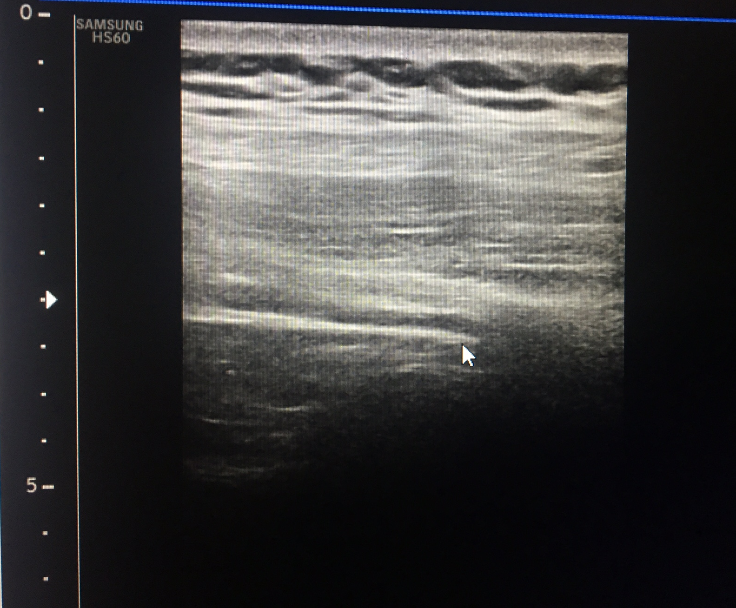

Slide 25
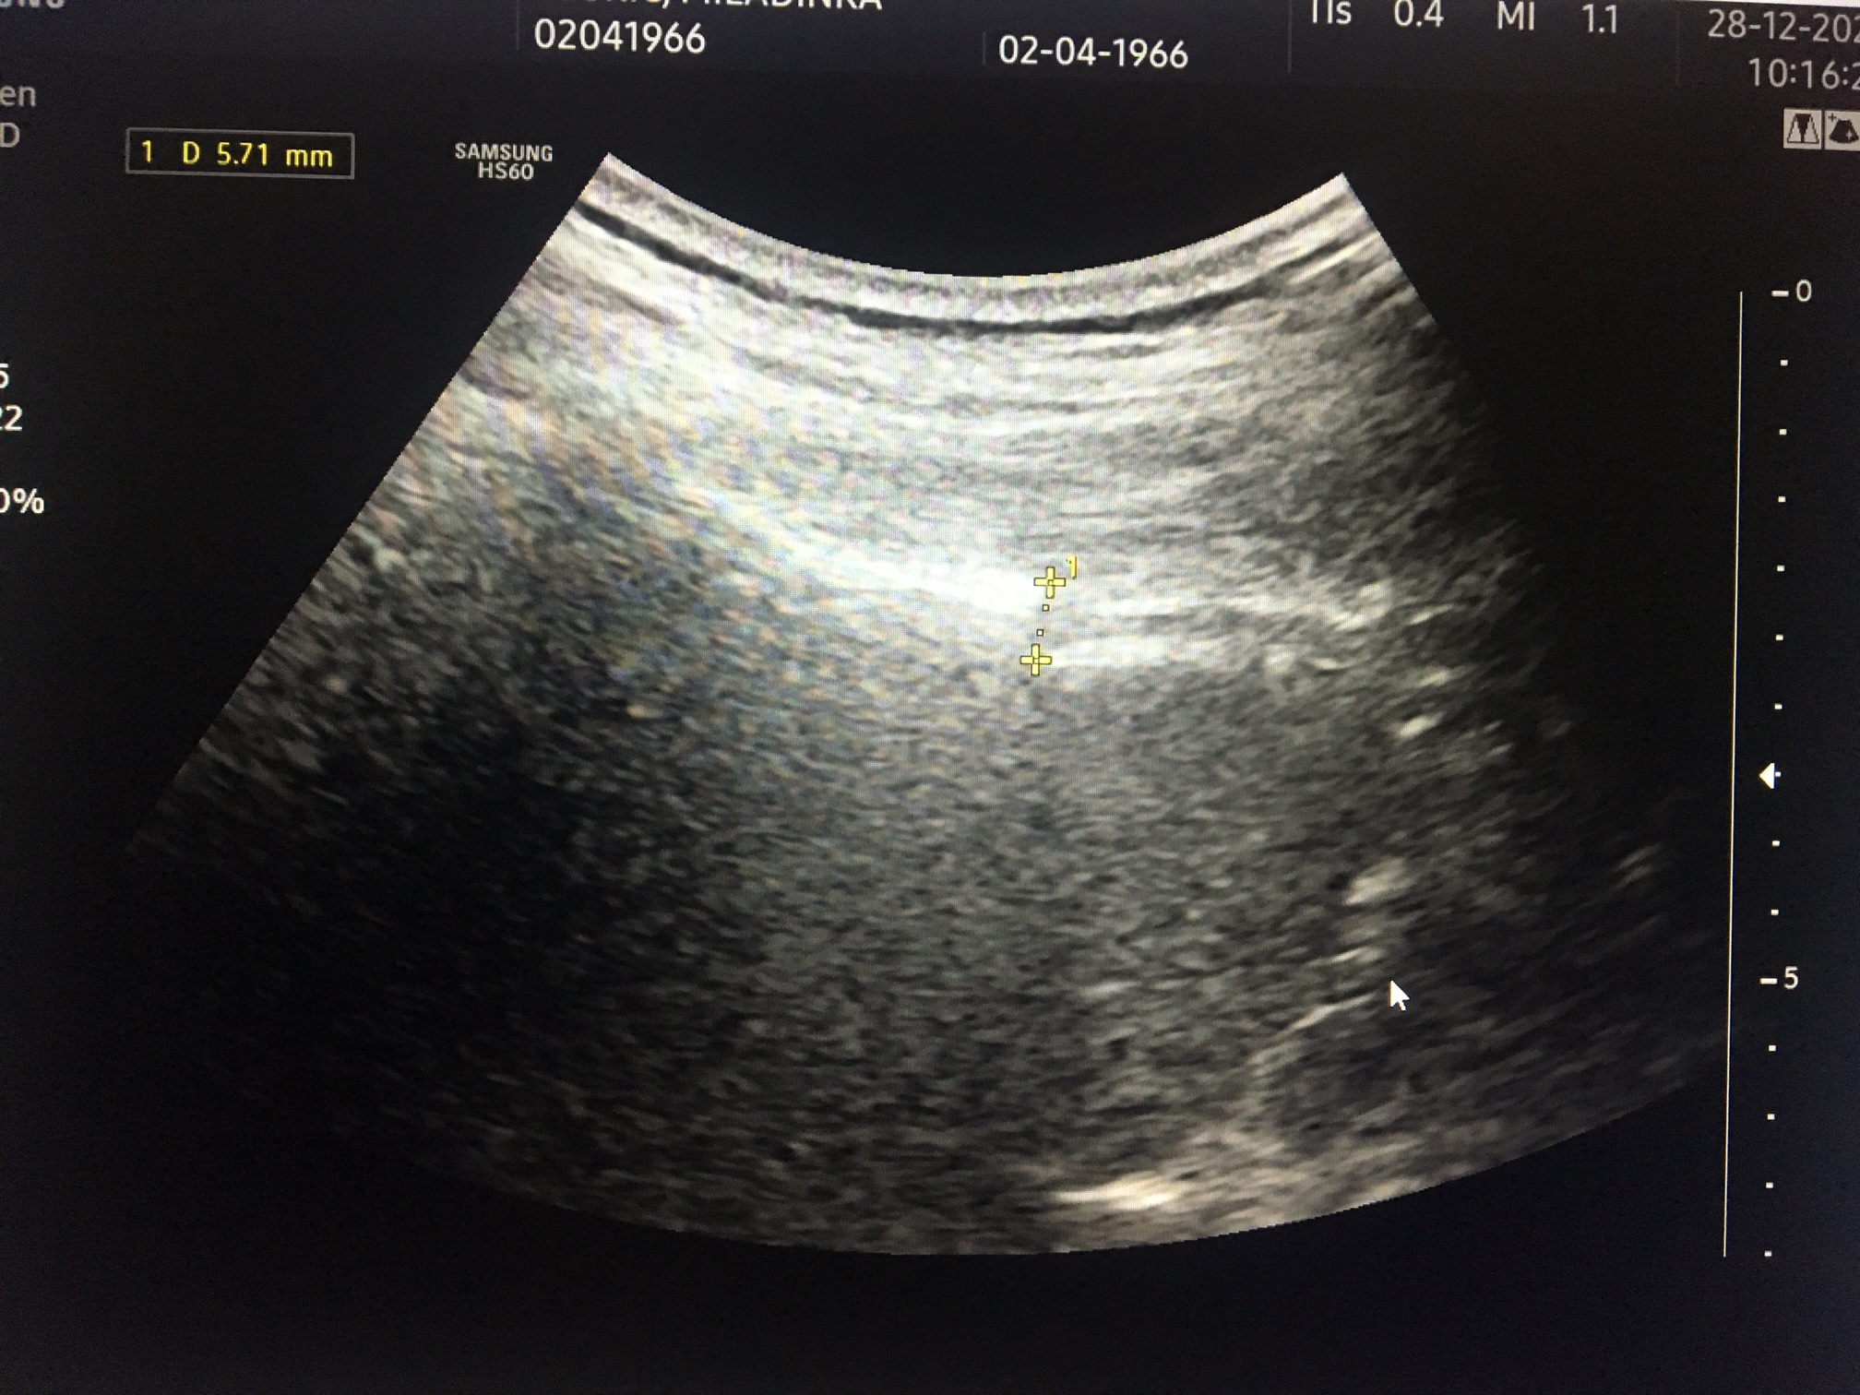

Slide 26
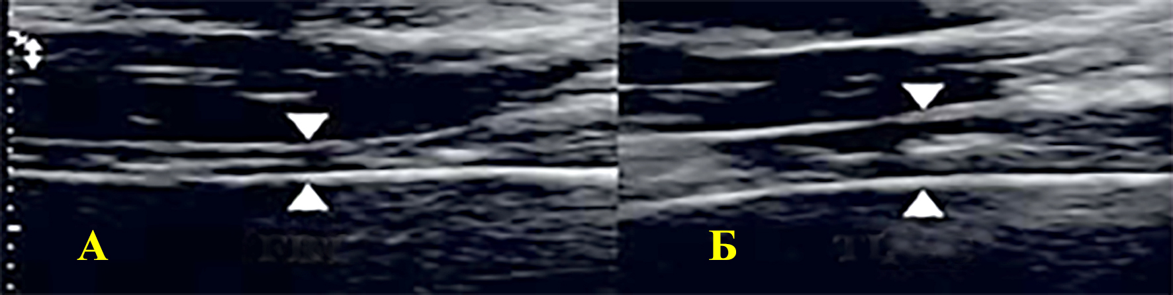
A-Min diameter during expirium
B- max diameter during inspirium

Slide 27
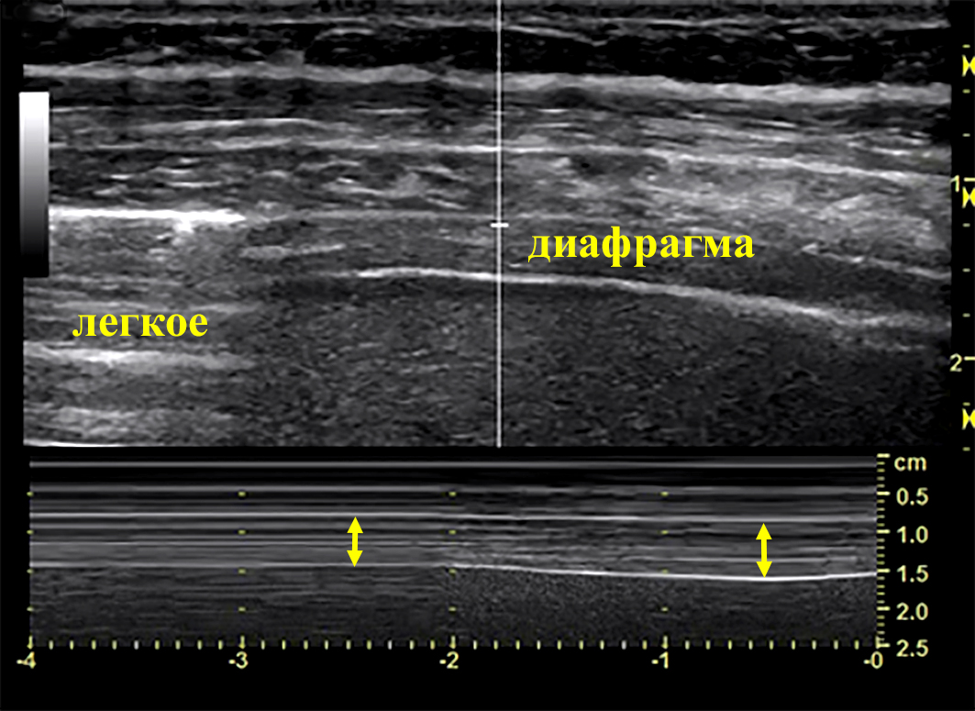
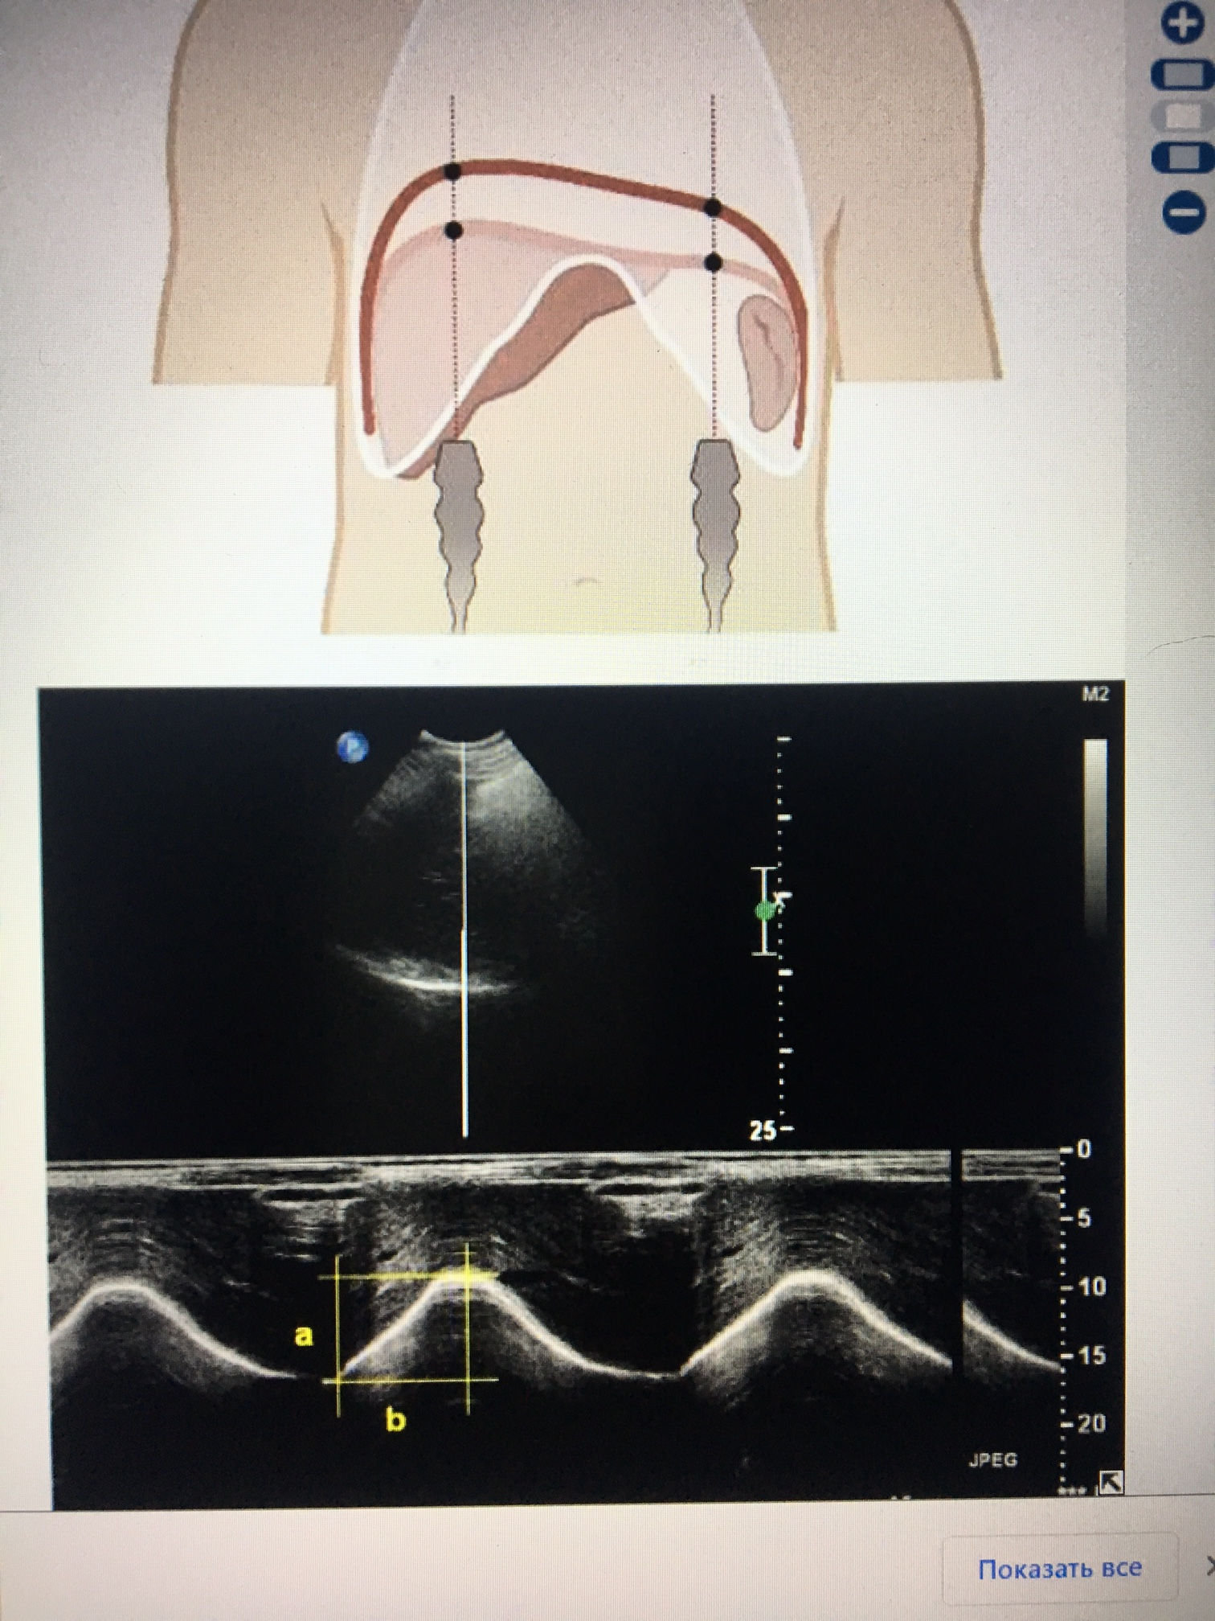
M-mod : cursor on diaphragm,
at the place without the lung tissue
Three cycles of breathing: middle value, same researches maximum value

Slide 28
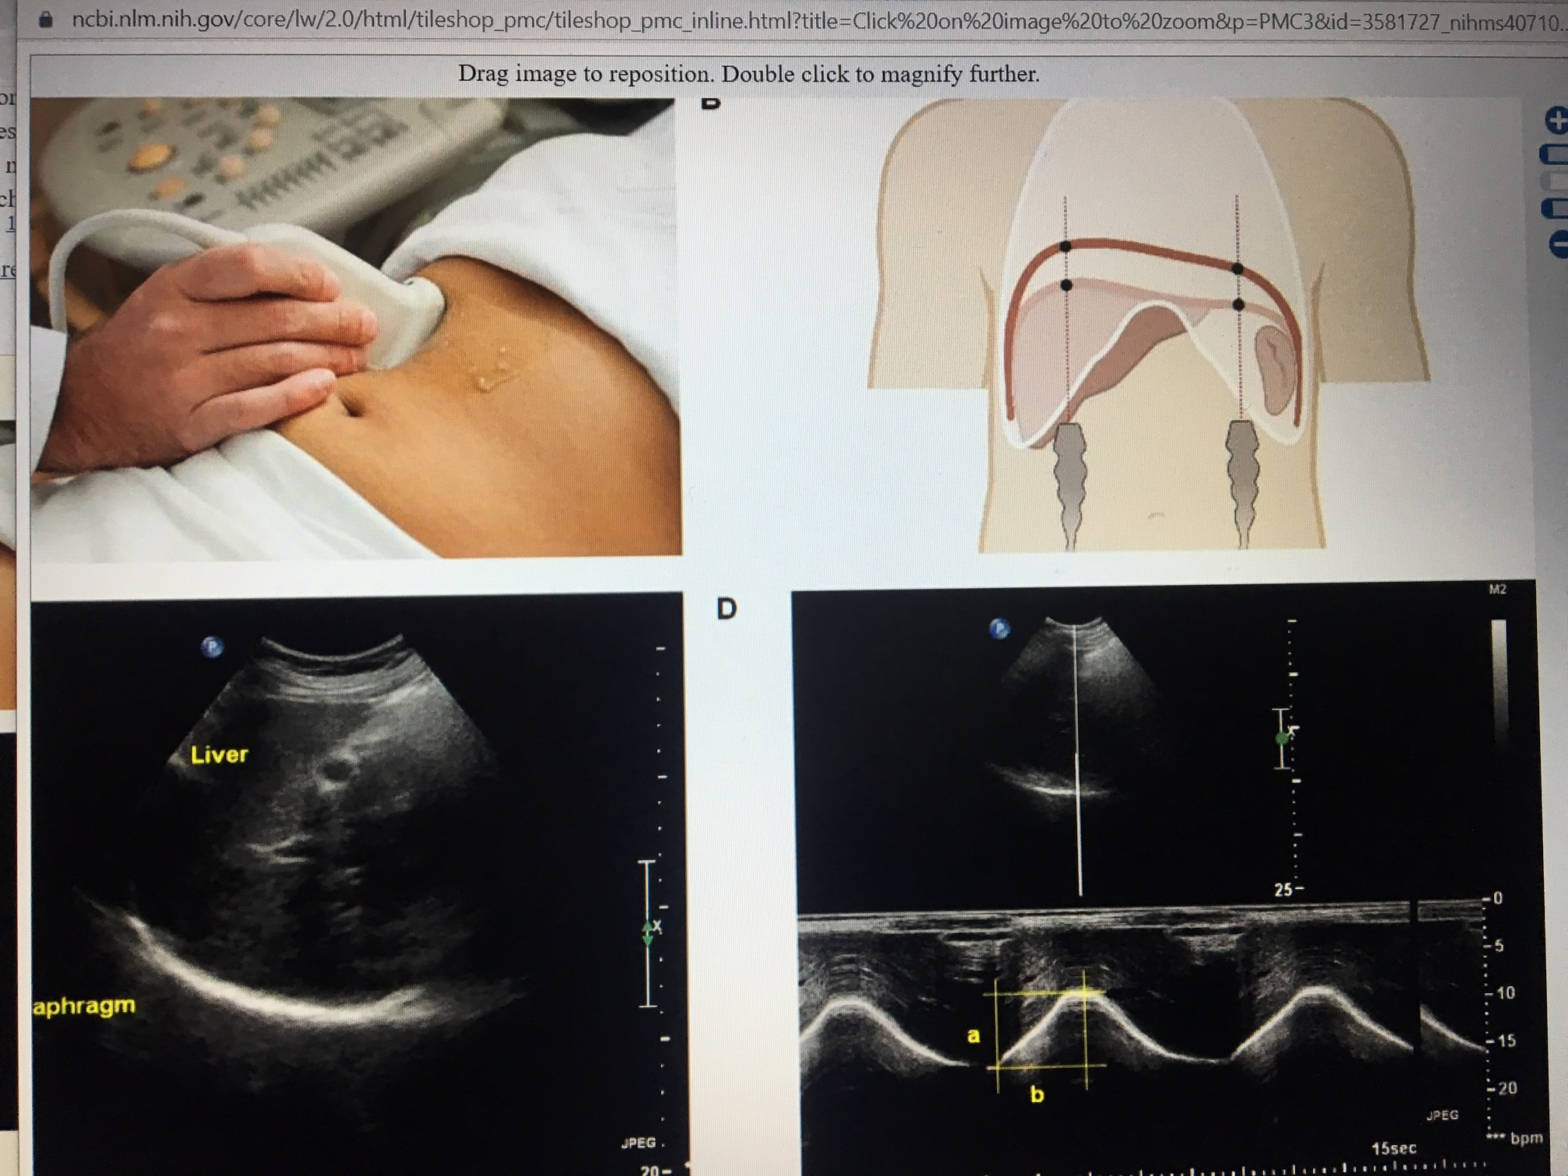
Anterior subcostal view
evaluating diaphragm excursion
Curvilinear transducer (2 to 6 MHz), Bmode, Mmode
liver and spleen window
between the mid-clavicular and anterior axillary lines and directed medially, cranially, and dorsally
The ultrasound beam reaches the posterior third of the right diaphragm approximately 5 cm lateral to the inferior vena cava foramen.

Slide 29
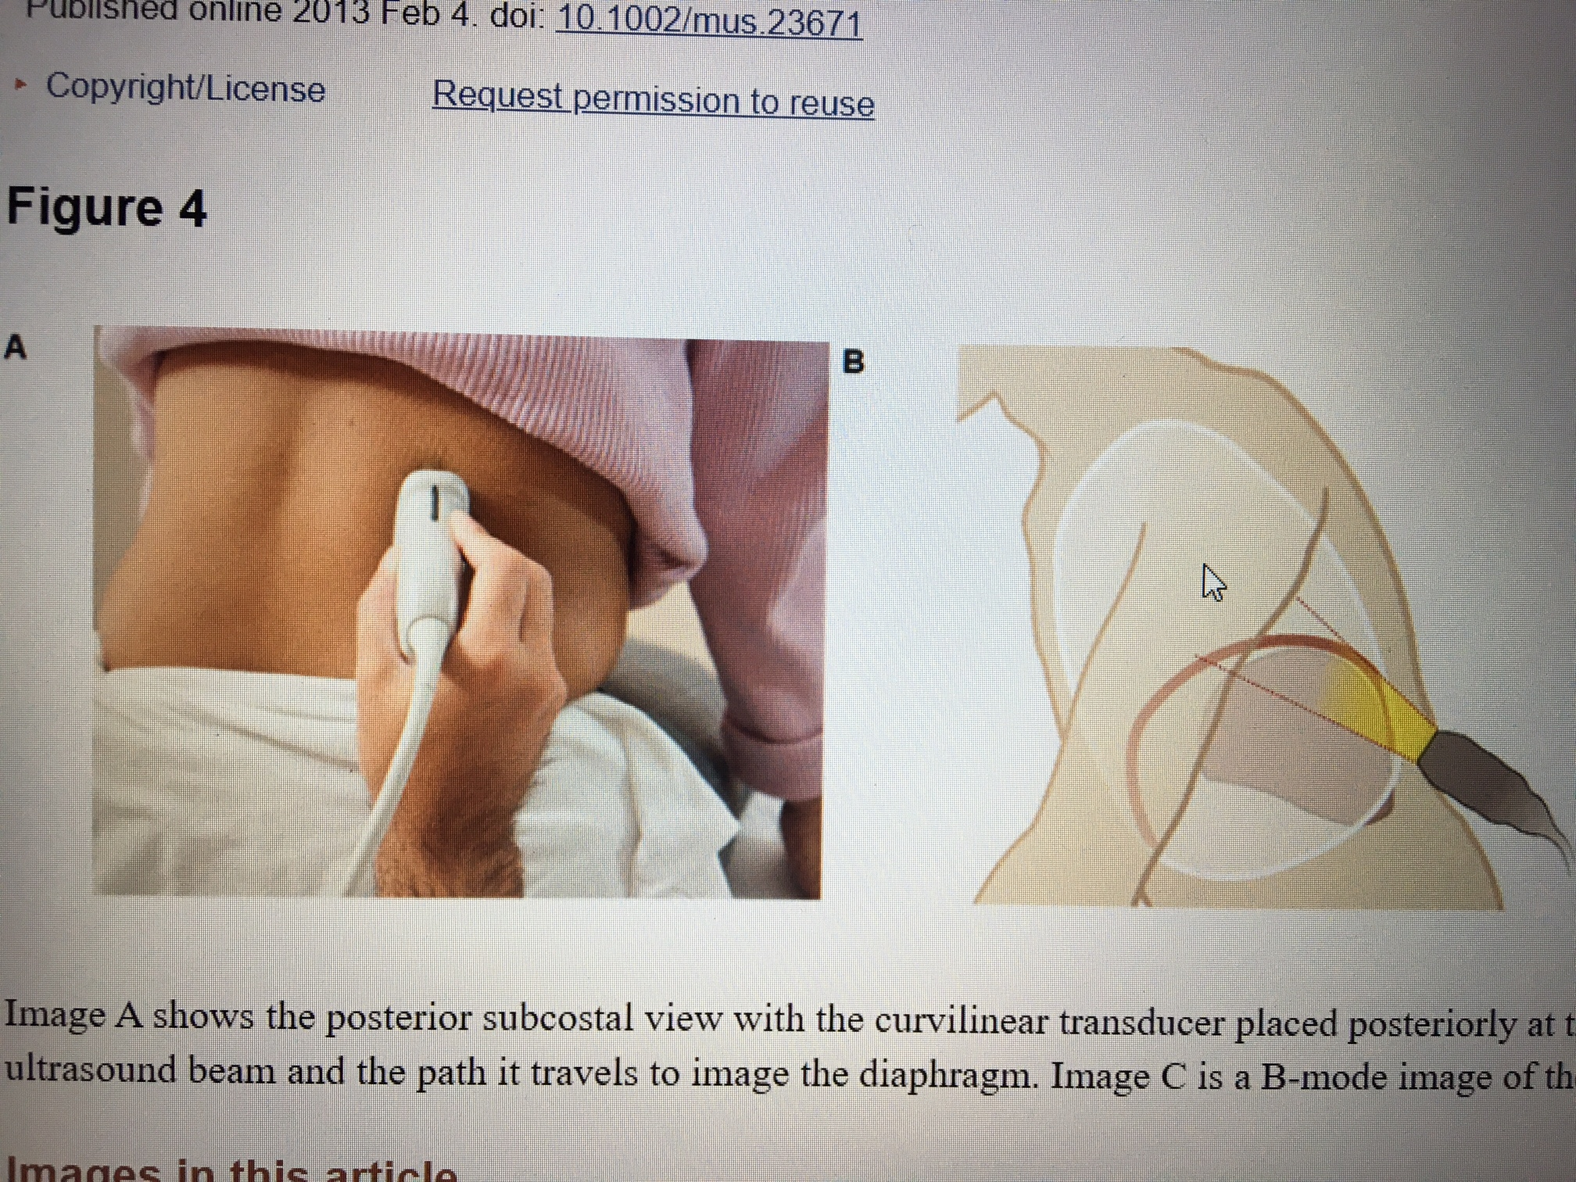
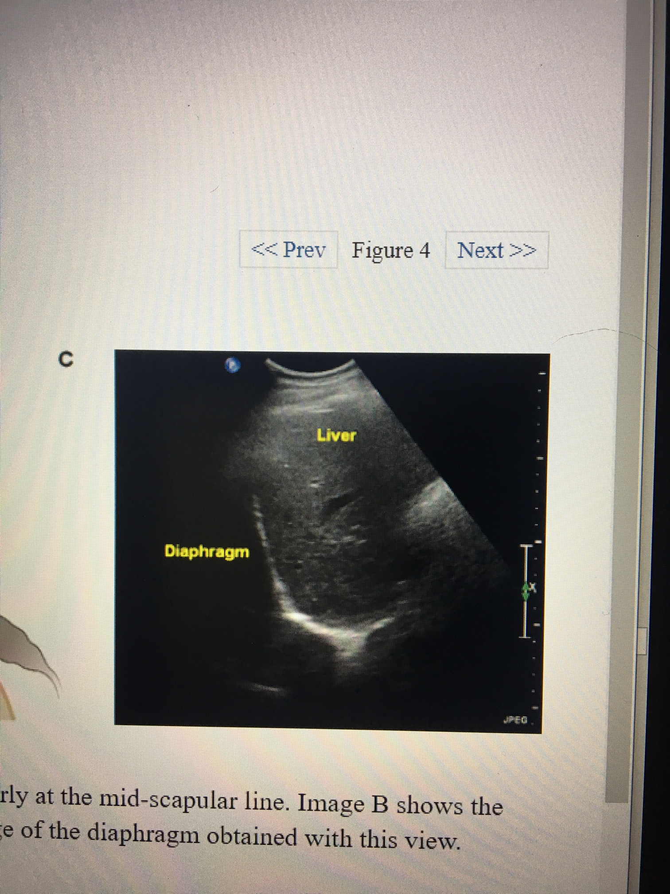
Posterior subcostal view
Not commonly use technique:
This view requires patients to be seated, which may not be practical in critically ill or mechanically ventilated patients

Slide 30
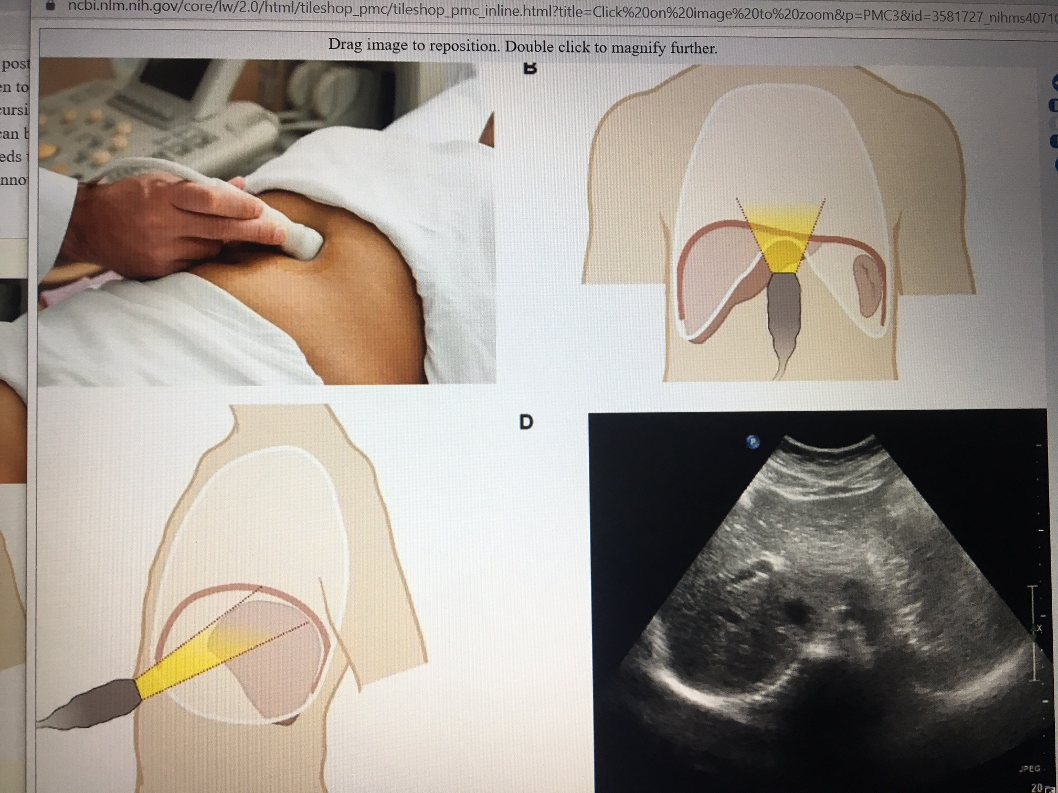
Subxyphoid view
particularly useful in children.
A curvilinear transducer (2 to 6 MHz), in a transverse orientation, Bmode,Mmode
angled upwards towards the posterior leaflets of the diaphragm
A portions of both domes can be seen together on an oblique transverse view
a qualitative comparison of their excursion can be done in real time
quantitative side-to-side variability: M mode; simultaneous measurements cannot be made, although both domes can be visualized at the same time.

Slide 31

What we can diGNOSED?

Slide 32
The compressive neuropaties
Carpal tunnel syndrome

Slide 33
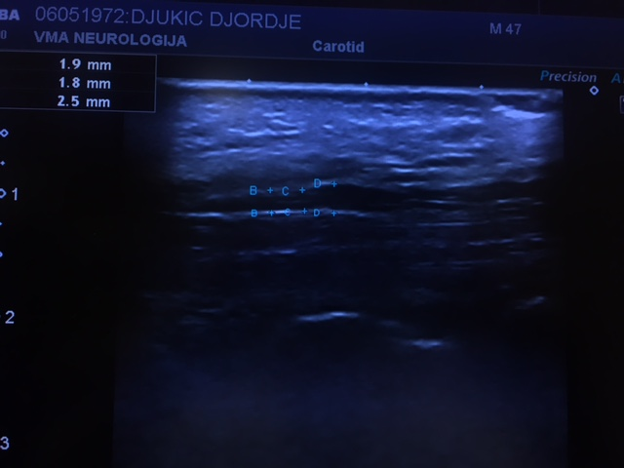
The compressive neuropaties
Carpal tunnel syndrome

Slide 34
The compressive neuropaties
Carpal tunnel syndrome

Slide 35
The compressive neuropaties
Carpal tunnel syndrome

Slide 36
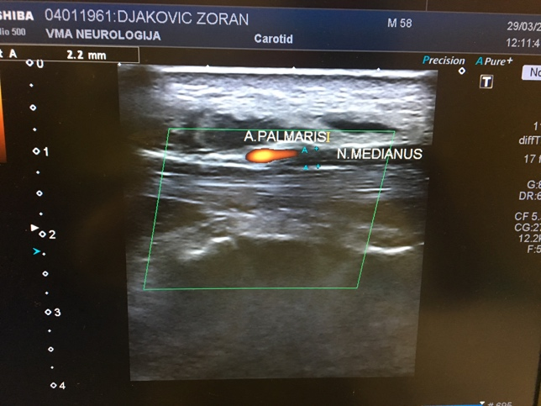
The compressive neuropaties
Carpal tunnel syndrome

Slide 37
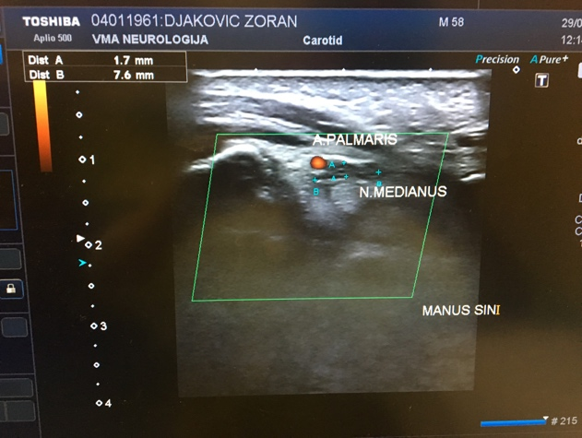

Slide 38
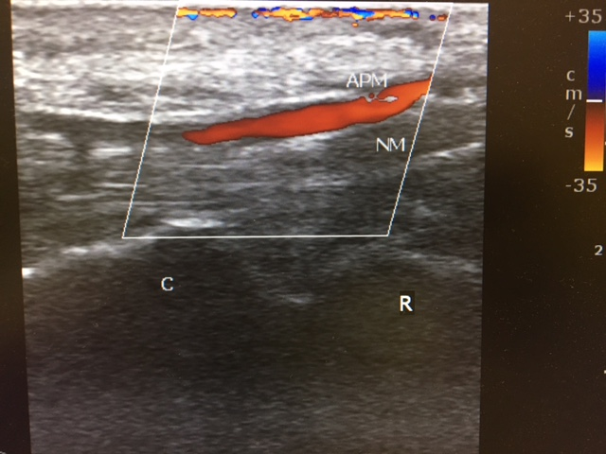

Slide 39
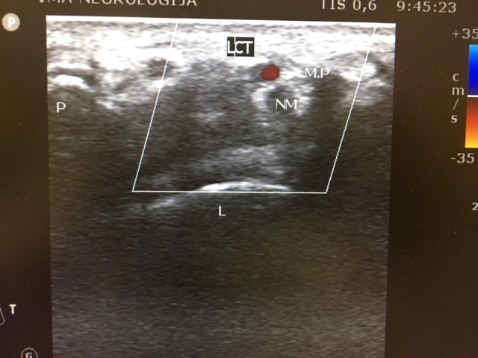

Slide 40
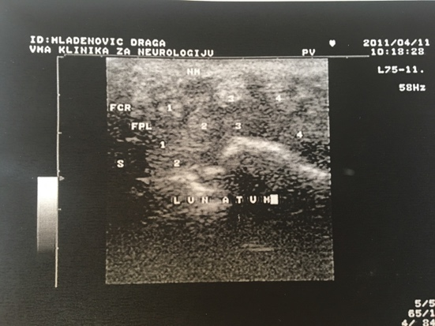
The compressive neuropaties
Carpal tunnel syndrome

Slide 41
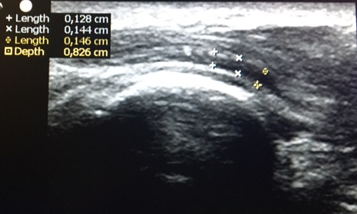
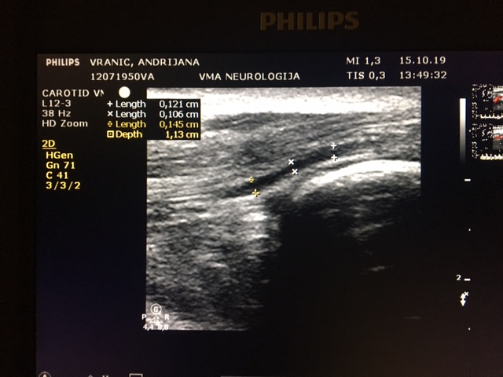
Cubital tunnel syndrom

Slide 42
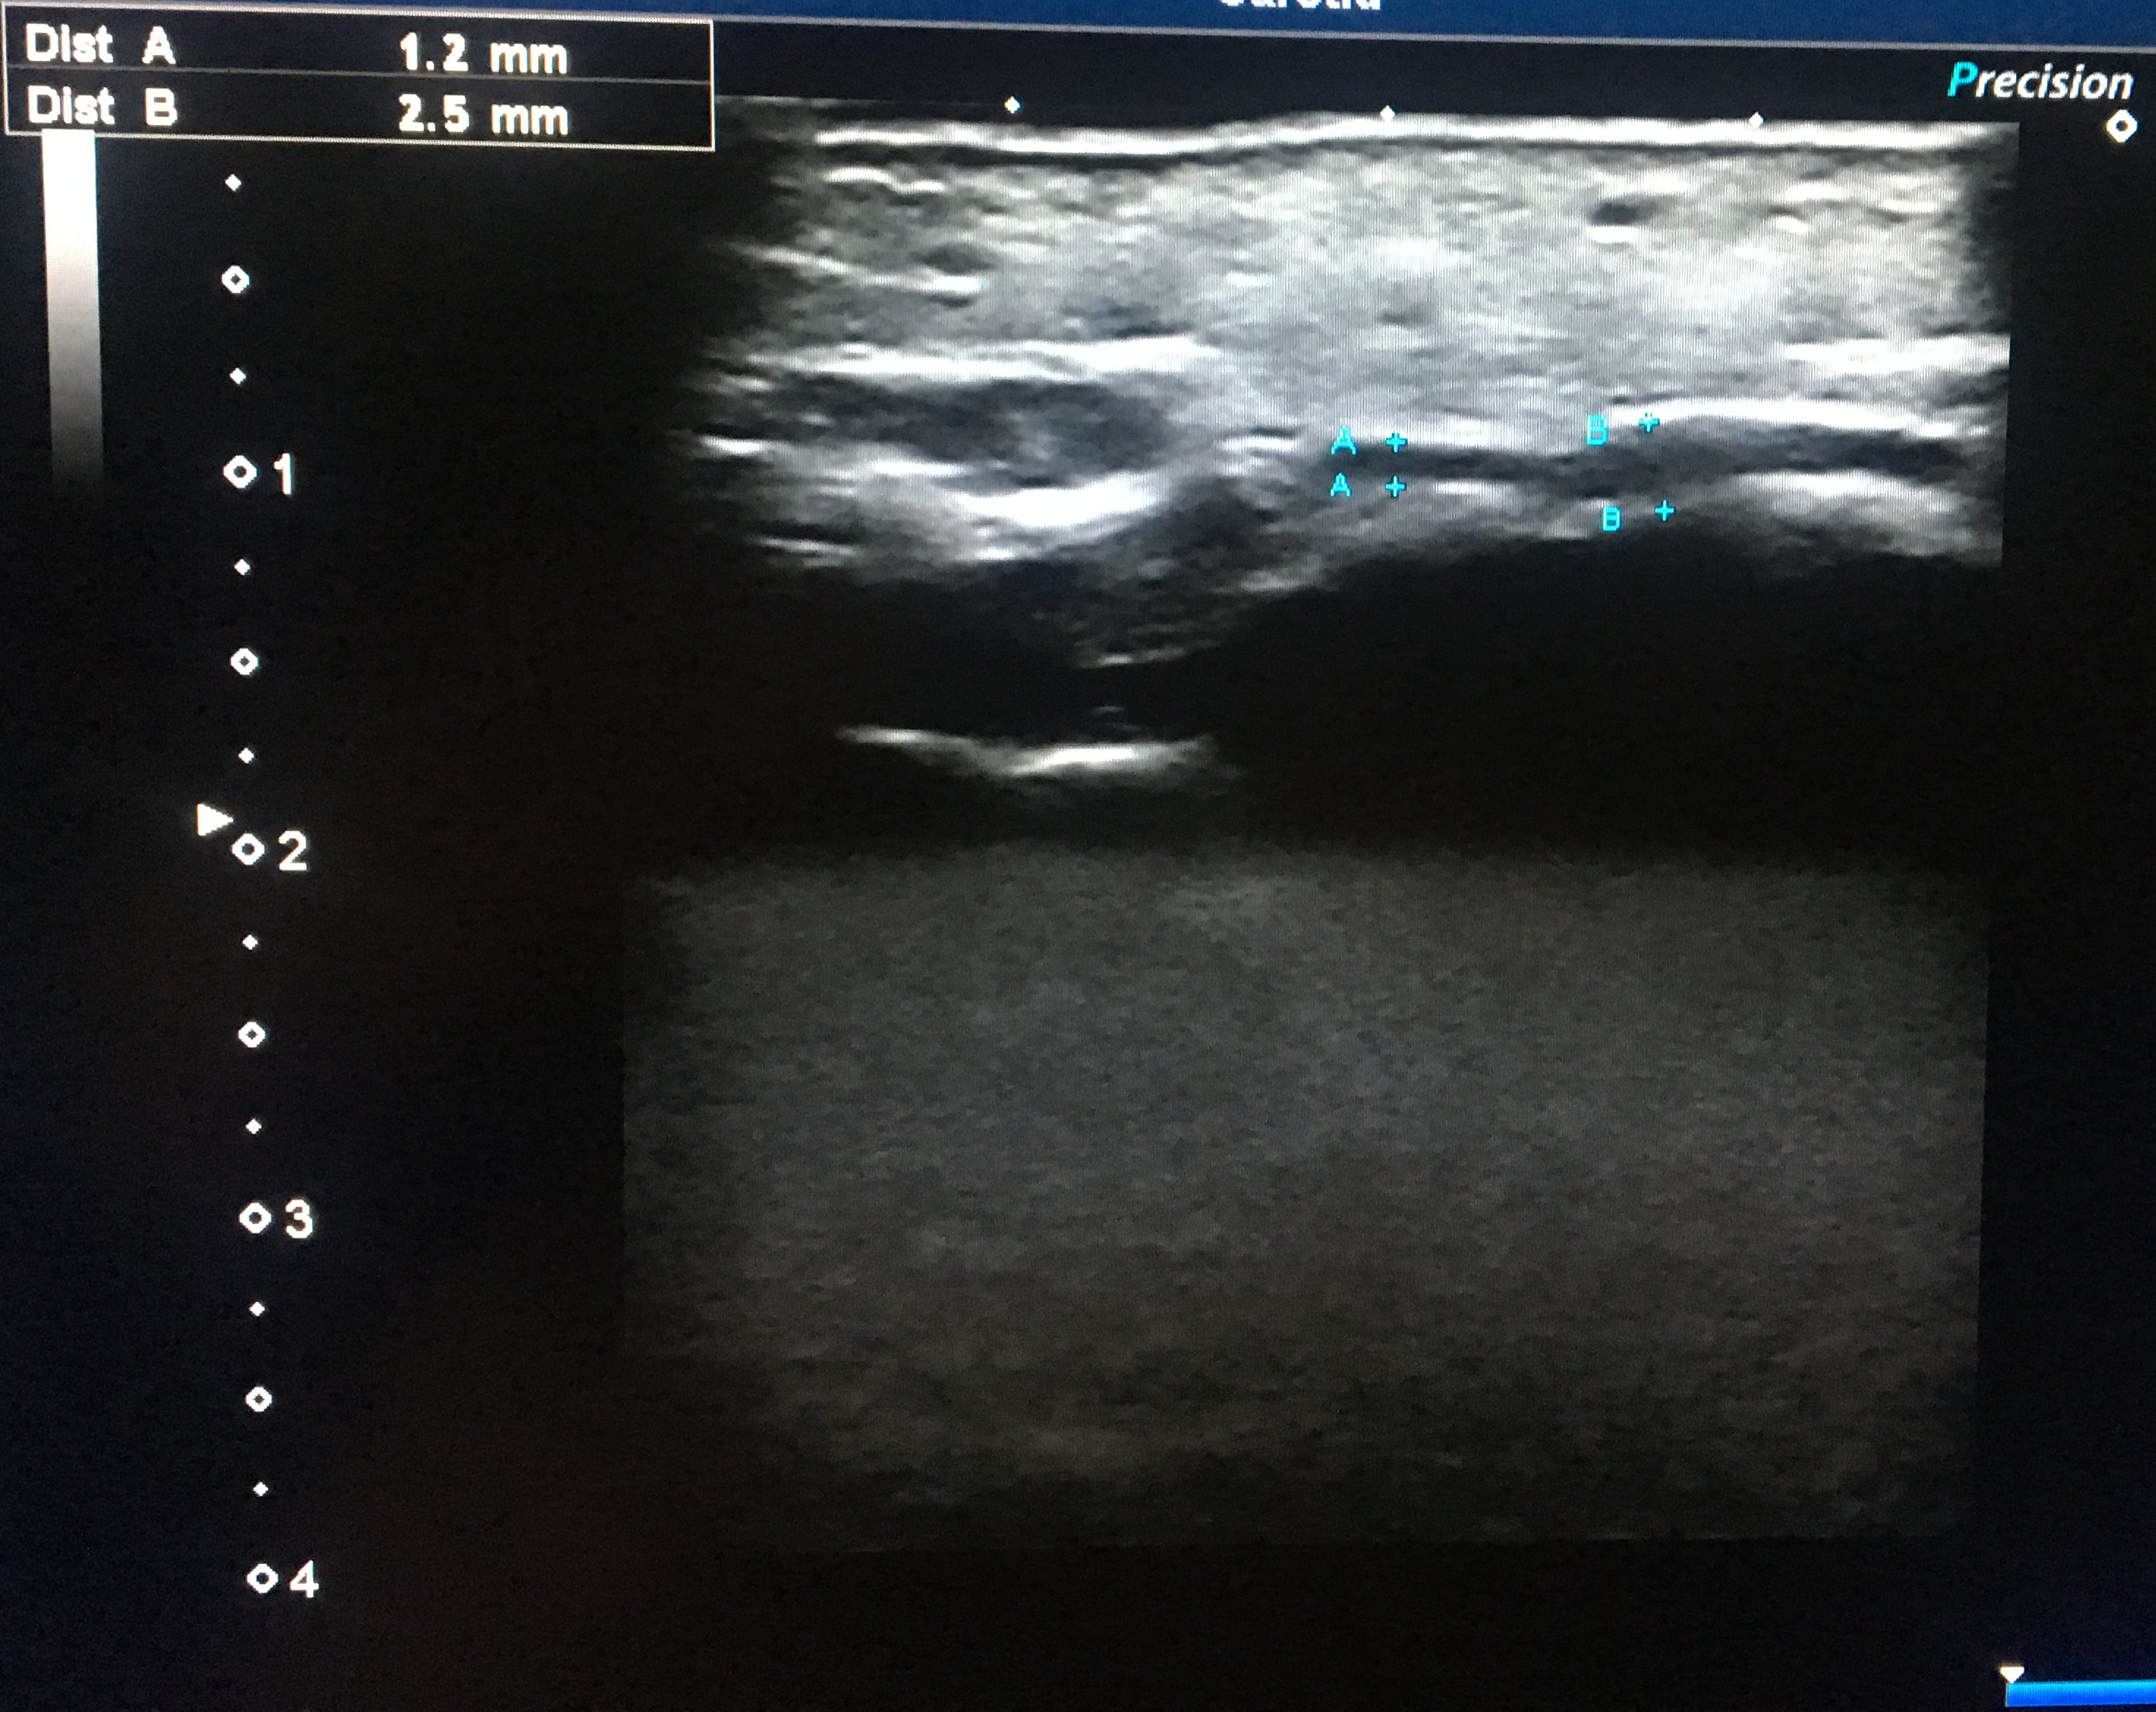
Cubital tunnel syndrom

Slide 43
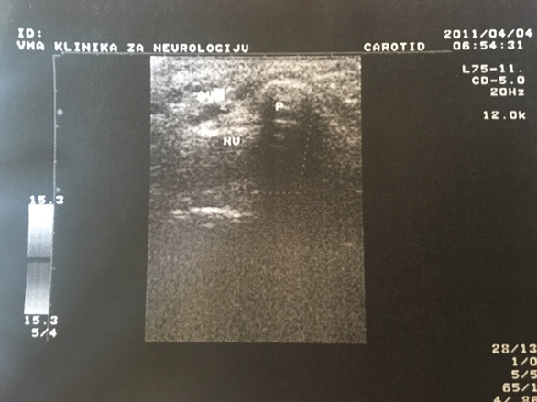

Guyon tunnel sy

Slide 44


Common peroneal nerve compression sy

Slide 45


Morton neuroma

Slide 46

Meralgia paresthetica

Slide 47
Thoracic outlet sy

Slide 48
Thoracic outlet sy

Slide 49

Polineuropathy
Polineuropathy in diabetes

Slide 50
Polineuropathy in diabetes

Slide 51
Neuropathy in hypothyreosis

Slide 52

Neuropathy in hypothyreosis

Slide 53

Neuropathy in hypothyreosis

Slide 54

Paraneoplastic sy

Slide 55
Paraneoplastic sy

Slide 56

Mononeuritis multiplex

Slide 57

Tumor and tumor like leasons of periferal nerves and muscles
Lepra

Slide 58
Amiloidosis

Slide 59

Trauma of the periferal nerve and/or muscle

Slide 60
Torsion of the periferal nerves

Slide 61

The new area of application

Slide 62
The new area of application this type of ultrasonography
Elastography of periferal nerves
Neuropathic pain treatment in real time
Immune – mediated neuropathies
Multifocal motore neuropathy
Guillain Barre sy
Charcot- Marie-Tooth sy
CIDP
Immune-mediated plexitis
Mononeuritis multiplex- polyneuropathy in vasculitis

Slide 63


